Slide 1

NETSPARKER REPORT

Slide 2
Netsparker is a security scanner for web applications. Netsparker is a piece of software that detects existing vulnerabilities in online applications and provides detailed reports with recommendations for how to fix them. It enables you to close the cybersecurity talent gap and totally automate web security activities.
NETSPARKER

Slide 3
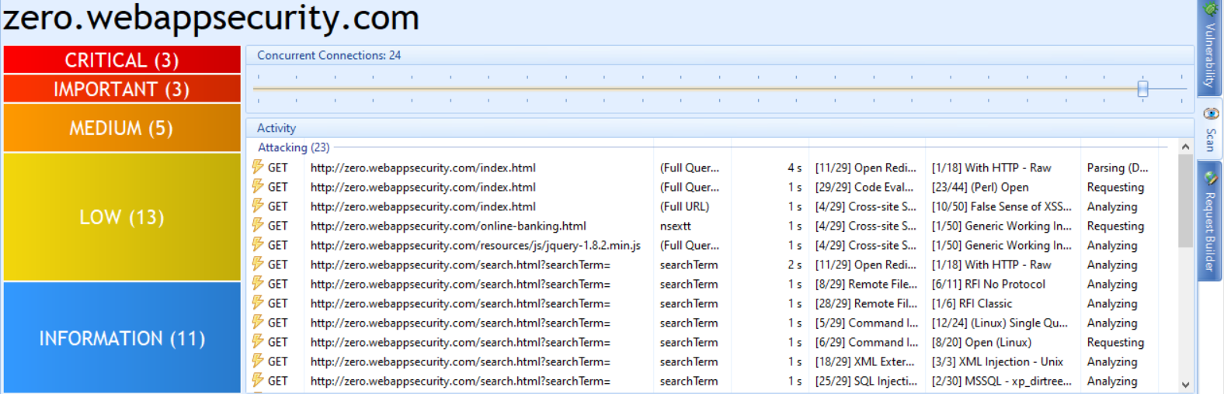
After the start of scan we can see 3 critical vulnerabilities in zero.webappsecurity.com website. These three vulnerabilities are related to out-of-date version which leads to known vulnerabilities like css,csrp and many more.

Slide 4
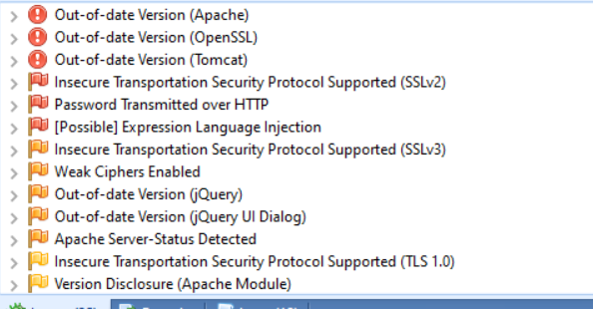
The below are the issues found in scanning using netsparker.

Slide 5
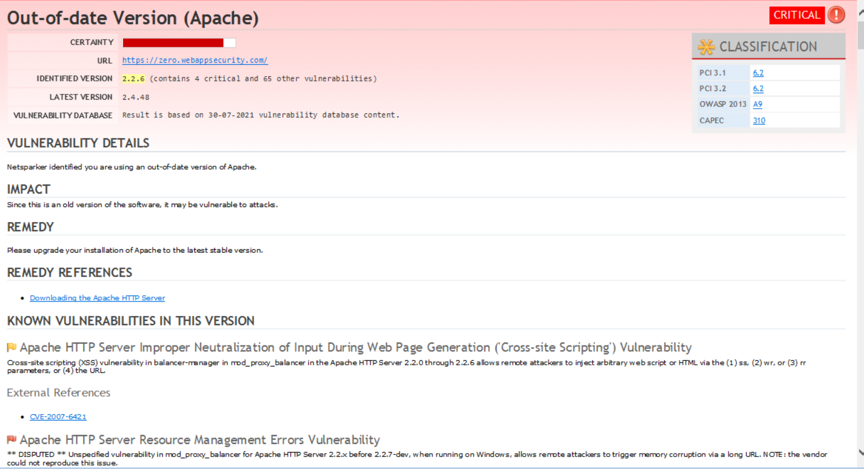

Slide 6
The below pdf is the report analysis based on the scanning results produced by netsparker
for the website: zero.webappsecurity.com

Slide 7
THANK YOU

